Slide 1
L04.02 AVL Trees
50.004 Introduction to Algorithm
Dr. Simon LUI
ISTD, SUTD

Slide 2
Overview
1
5
Review Binary Search Trees
The Importance of a balanced tree
AVL Tree
It is one kind of balanced tree
definition
rotations, insertion
6
7
10
7
12
5
10
1
6
12

Slide 3
BST review
Each node x has:
key[x]
Pointers: left[x], right[x], p[x]
Property: for any node x:
For all nodes y in the left subtree of x:
key[y] ≤ key[x]
For all nodes y in the right subtree of x:
key[y] ≥ key[x]
root
Parent[x]
10
5
12
1
6
7
leaf
Tree height = 3

Slide 4
BST for runway reservation system
R = (37, 41, 46, 49, 56) current landing times
remove t from the set when a plane lands
R = (41, 46, 49, 56)
add new t to the set if no other landings are scheduled within < 3 minutes from t
40 => reject (41 in R)
42 => reject (41 in R)
53 => ok
delete, insert take O(h), h=height of the tree
5-1
49
3-1
1
41
56
1
1
37
46
4+1
49
2
1+1
41
56
1
1
46
53

Slide 5
The importance of being balanced
for n nodes:
h = Θ(log n)
h = Θ(n)

Slide 6
Balanced BST strategy
Augment every node with some property
Define a invariant on the property
Show that the invariant guarantees Θ(log n) height
Design algorithms to maintain the property and the invariant

Slide 7
AVL Trees: Definition [Adelson-Velskii and Landis’62]
Property: for every node, store its own height (“augmentation”)
Leaves have height 0
NIL has “height” -1
Invariant: for every node x, the heights of its left child and right child differ by at most 1
0
0
0
h=k+1
x
h=k
h=k-1

Slide 8
Now the proof…. AVL Tree’s height is Θ(log n)

Slide 9
AVL trees have height Θ(log n)
Let n_{h} be the minimum number of nodes of an AVL tree of height h
We have
h
h-1
h-2
- Let m_{h} be the max number of nodes of an AVL tree of height h
m_{h} <= 2^{h}
log(m_{h}) <= h

Slide 10
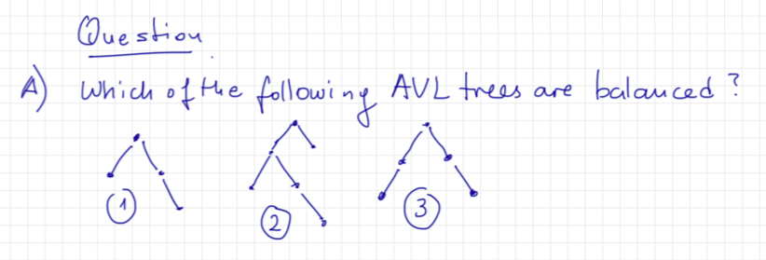
Exercise

Slide 11
Tree acrobatics! - Rotations
B
RIGHT-ROTATE(B)
A
A
LEFT-ROTATE(A)
B
γ
α
α
β
β
γ
Rotations maintain the in-order ordering of keys:
Rotations can reduce the height!
2
1
1
2
LEFT-ROTATE(1)
1
1
3
2
0
0
0
3

Slide 12
Insertions/Deletions
h
Insert new node u as in the simple BST
Can create imbalance
Similar issue/solution when deleting a node
h-1
h-2
h
+1
h-1
h-2
u

Slide 13
Balancing
x
Let x be the lowest “violating” node (we will try to correct that)
Assume that x is “right-heavy”
(hence we analyze more the right subtree of x)
y = right child of x
Scenarios:
Case 1: y is right-heavy
Case 2: y is balanced
Case 3: y is left-heavy
k-1
k+1
x is “right-heavy”
no violation
x
no violation
A
y
B
C
Notes:
No violation in the subtrees

Slide 14
Case 1: y is right-heavy
x
y
LEFT-ROTATE(x)
y
k+1
x
C
k-1
A
k
B
C
A
B
k
k-1
k-1
k-1

Slide 15
Case 2: y is balanced
x
y
LEFT-ROTATE(x)
y
k+1
x
C
k-1
A
k
B
C
A
B
k
k
k-1
k
Same as Case 1

Slide 16
Case 3: y is left-heavy
x
y
LEFT-ROTATE(x)
y
k+1
x
C
k-1
A
k-1
B
C
A
B
k-1
k
k-1
k
Need to do more …

Slide 17
Case 3: y is left-heavy
RIGHT-ROTATE (y)
x
LEFT-ROTATE(x)
A
y
k+1
z
k-1
C
y
z
k
x
k
k-1
A
B
k-1
or
k-2
D
C
k-1
B
D
k-1
or
k-2
k-1
And we are done!

Slide 18
Examples of insert/balancing

Slide 19
Conclusions
In balanced BSTs all operations take O(logn) time
Can maintain balanced BSTs using O(logn) time per insertion

Slide 20
Exercise
Let’s look at AVL tree exercise.ppt

